Slide 1
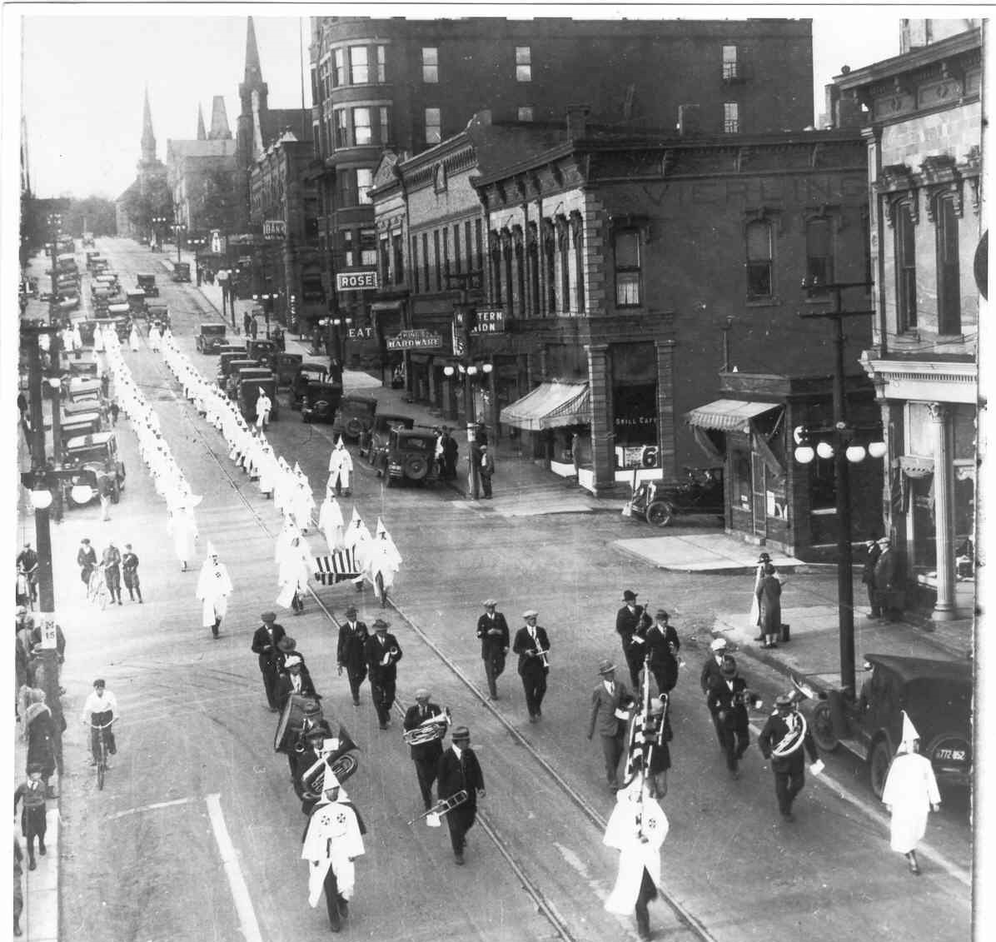

Slide 2
The Second Klan “Movement”
Inspired, in part, by Thomas Dixon’s novel, The Clansman (1905), and D.W. Griffith's film Birth of a Nation (1915)
Founded in Atlanta, Georgia (1915)
Nativist, xenophobic, petty nationalism
Enjoyed wide-spread support, especially in the mid-West and Western states. By 1925, the KKK reputedly had 4.5 million members.
A successful “third party”
KKK March on Washington, 1925.

Slide 3
Protestant Hegemony
Large influx of immigration from southern and central Europe
Virulent anti-Catholicism and anti-Semiticism
Allegiance to papal authority
Prohibition violation, sexual immorality, threats to religion and “traditional family values.”

Slide 4
Red Scare
Bolshevik revolution in Russia (1917)
Socialist Party of America
Industrial Workers of the World (IWW)
Seattle General Strike (1919)
Anarchist bombings
Palmer Raids (6,000 arrested and 556 deportations)

Slide 5
Anti-Immigration Legislation
The Quota Law of 1921 restricted annual immigration to approximately 350,000 persons. Limited annual immigration from any one country to 3% of 1910 numbers.
Immigration Act of 1924. By 1930, annual immigration limited to 150,000. Disproportionate by ethnicity and country of origin. Asians completely excluded.
Northern European: 86.5 %
Southern / Central Europe: 11.2 %

Slide 6
Marquette County Immigration from South and Central Europe
41,239
46,739
45,786
44,076
Less than 1%
5 %
4%
3%

Slide 7
Violation of Prohibition Laws

Slide 8
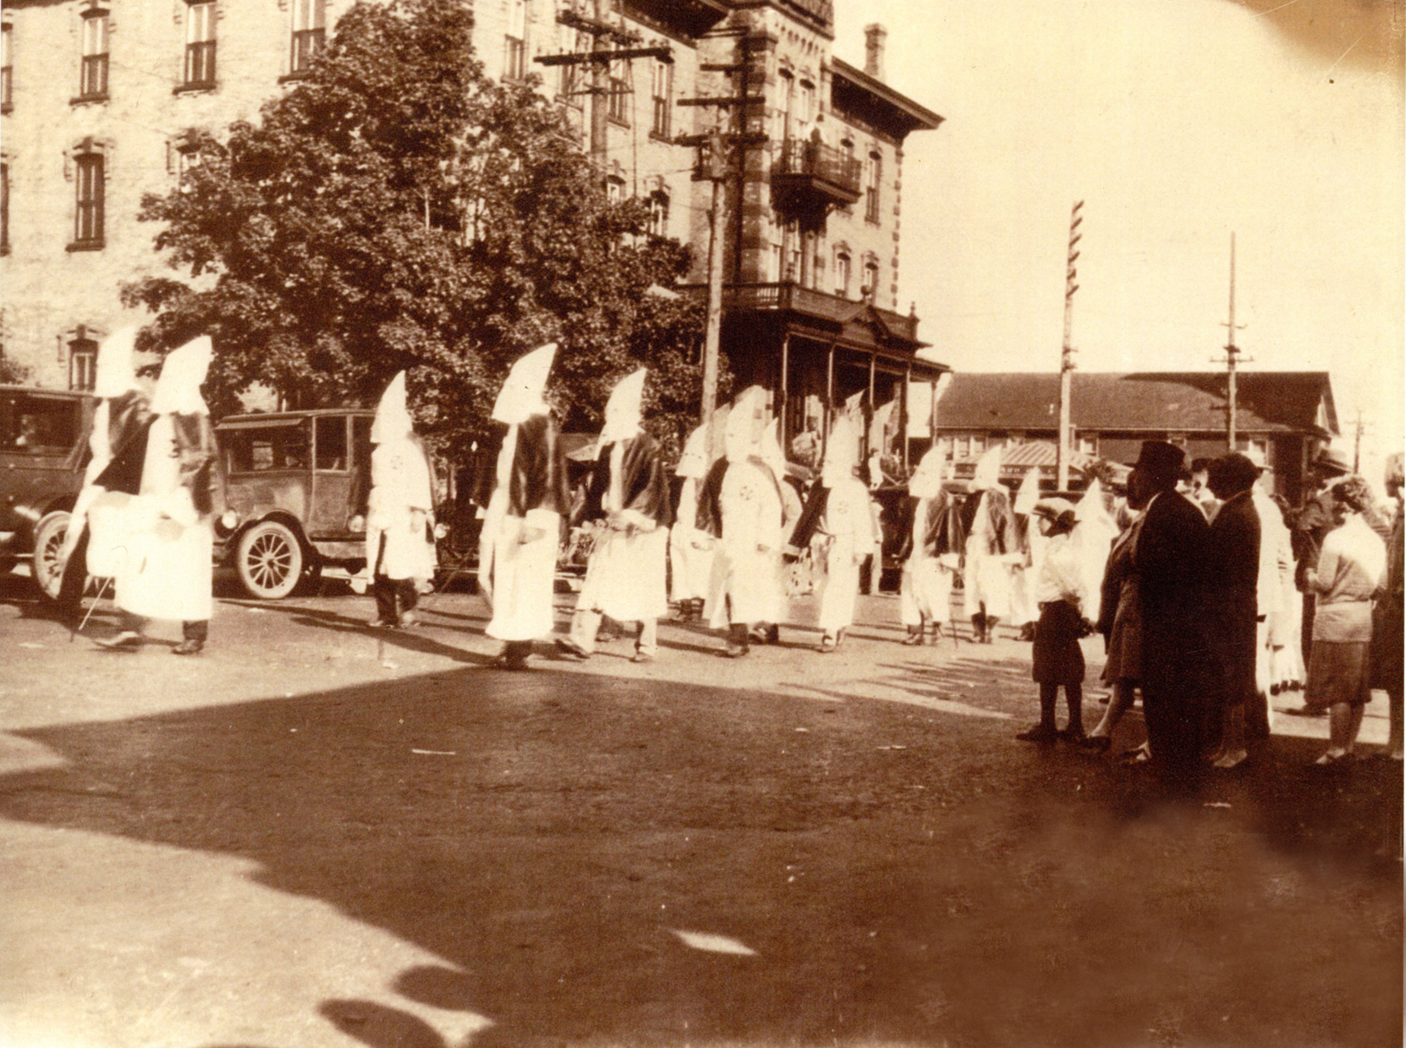

Slide 9
