Slide 1
“This Unfortunate Accident”
Death in the Iron Mines,
1898-1940

Slide 2
The Failure of Organized Labor?
Depression 1893 (workforce dropped from 17,000 to 3,500, causing massive out migration)
Strike of 1895 (3,000 miners; state militia; independent union led by Cornish continued)
Strike of 1899 (2,700 miners; split between Cornish and Finnish miners)
WFM, IWW, Finnish Socialist Association (SPA)
Outmigration Ishpeming declines 53% 1900-1930
1895 Strike Parade, Ishpeming

Slide 3
]
Cliffs Shaft Mine: Average Daily Wages and Cost of Production, 1909-1920 (Post WWI period of severe inflation and high demand for labor). Ford initiates revolutionary $5.00 day in 1915.

Slide 4
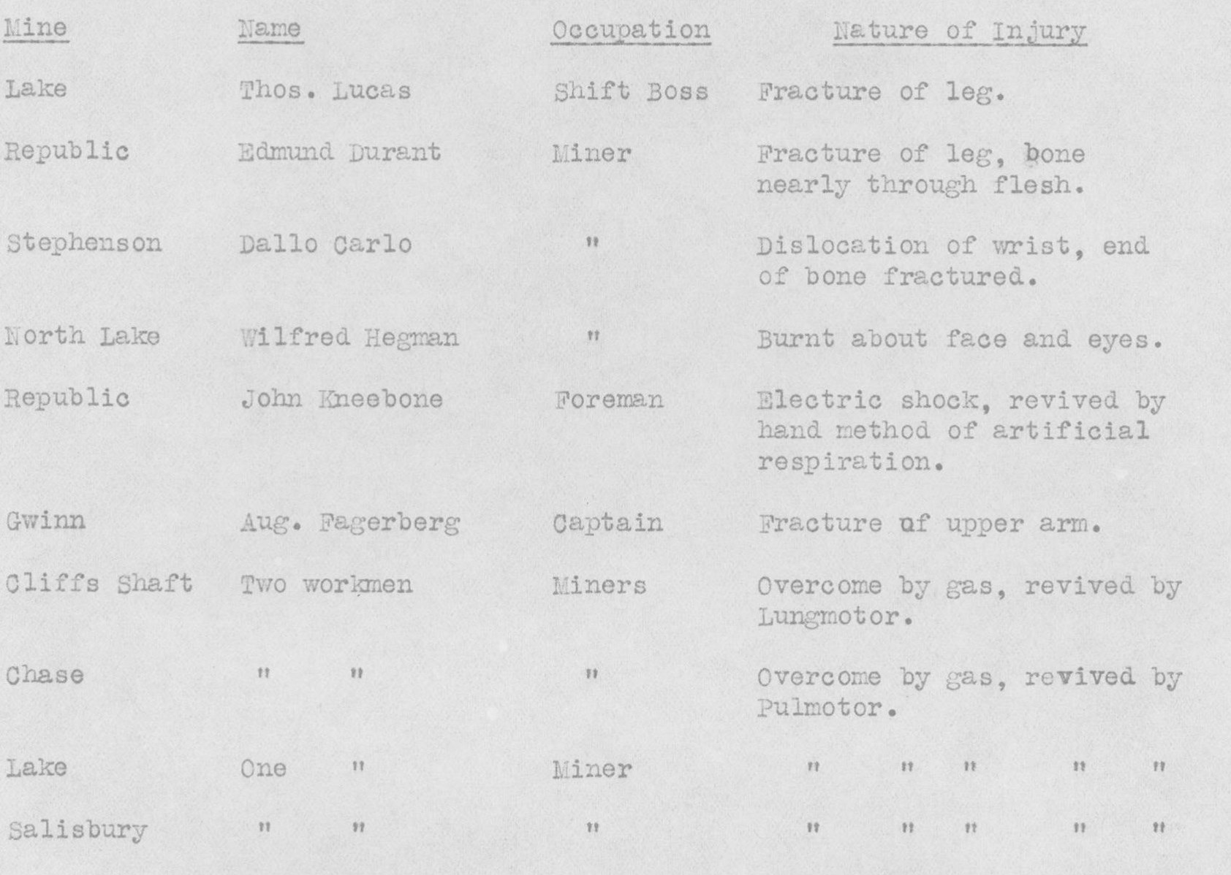
A Very Dangerous and Painful Profession (1920)

Slide 5
CCI Fatalities, 1898 - 1940
Total CCI Fatalities: 321 (1926 does not include Barnes-Hecker)
Total Marquette Iron Range Fatalities: 675
Mesabi Range Death Rate 7.5 / 1000

Slide 6
Deaths by Ethnicity
Time | English | Finnish | Swede | Irish | American | Italian
1900-1909 | 41 | 78 | 20 | 2 | 2 | 22
1910-1919 | 28 | 78 | 7 | 2 | 9 | 23
1920-1929 | 4 | 13 | 1 | 2 | 5 | 6
1930-1940 | 1 | 8 | 0 | 0 | 5 | 5
Foreign born population reached a peak of 47% in 1910. Finns largest component
Ethnic cohesiveness
Workplace camaraderie

Slide 7
Reason for Poor Safety Record (Prior to 1911)
Poor discipline in the mines
Contract System – Company paid a work team according to output. Worked fast, little oversight.
Demand for labor greater than supply (inexperienced miners)
Lack of laws forcing compensation for fatalities
Employee carelessness
CCI Miners, 1917

Slide 8
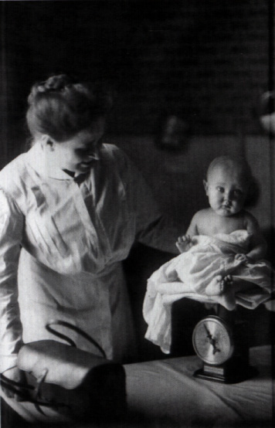
CCI’s Corporate Paternalism
William Mather / “Progressive Era”
Low rental housing and support for ownership (CCI owned 600 houses)
Community clubhouses and beautification awards
Pension Plan (1909)
Establishment of Gwinn as a model company town (1907)
Company sponsored health care
Visiting doctor and nurse program
Company maintained hospital (Ishpeming, 1918)
Company Initiated Safety Program (1911)
CCI Visiting Nurse, 1915

Slide 9
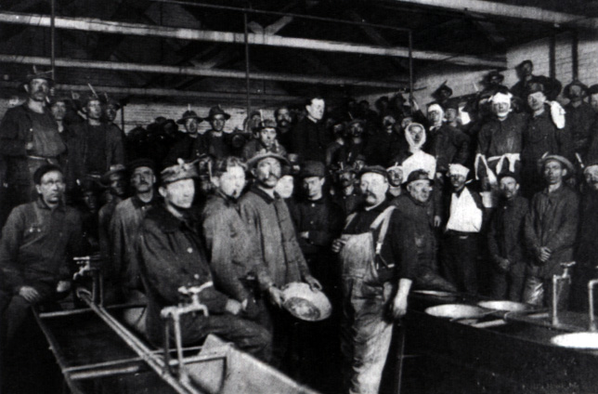
CCI Safety Program, 1911
Motivation for Implementation:
US Steel “Safety First Campaign” (1906) and Oliver Mining Co. (1910)
Michigan’s Workmen’s Compensation Law (1912)
Components of Safety Program:
William Conibear (first full-time, professional safety director in the industry), 1911
Improved sanitation, carbide lamps, phones, canaries
Safety regulations published in multiple languages
Local and Central Mine Safety Committees
Regular Mine Inspections
Tied promotions to safety record
Established five fully equipped rescue and first aid stations
Established regular safety training
CCI Safety Training Class, 1914

Slide 10
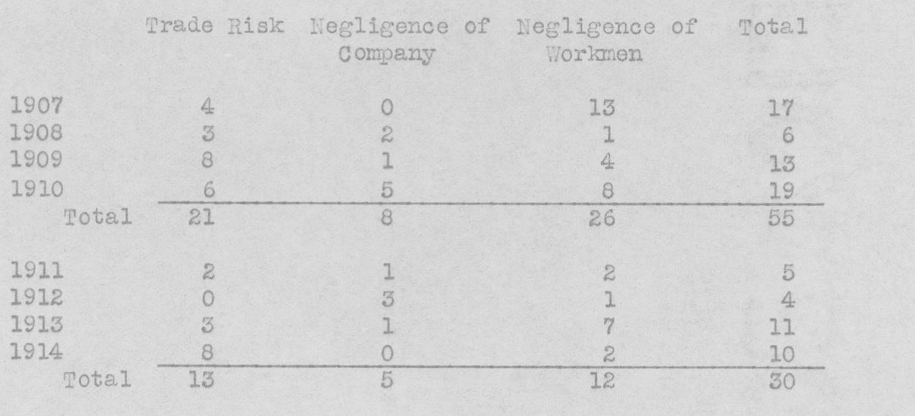
Three General Causes of Death
(CCI is found negligent in 35%)

Slide 11
