Slide 1
Pasties, Beer, Revolution, and God
Immigrant Miners and Their Communities on the Marquette Iron Range, 1900-1930

Slide 2
100 Bottles of Beer. . .

Slide 3
The Failure of Cornish Pasties: Marquette Iron Range, 1890 - 1900
Cornish miners began arriving after 1880 (eschewed open-pit mining). Never more than 25% of miners. 1909 dropped to 13%. Mining foremen, captains, etc…..
Depression 1893 (workforce dropped from 17,000 to 3,500, causing massive out migration)
Strike of 1895 (3,000 miners; state militia; independent union led by Cornish)
Strike of 1899 (2,700 miners; split between Cornish and Finnish miners)
1895 Strike Parade, Ishpeming

Slide 4
Revolution!
Industrial Workers of the World, 1905, (IWW) and the Western Federation of Miners (WFM), 1893
Socialist Party of America. Won over 900,000 votes 1912 and 1920 (E. Debs ran for president from prison)
Bolshevik revolution in Russia (1917)
Seattle General Strike (1919)
Anarchist bombings (Sacco and Vanzetti, 1920)
Palmer Raids (1919) 6,000 arrested and 556 deportations

Slide 5
Revolution: Hard Rock Mining Labor Wars, 1900 – 1930
Colorado Labor Wars, 1903-1904. Led by the WFM. Involved thousands of miners and intervention by the state militia, US Army, Pinkertons
Mesabi Iron Range Strikes, 1907 (WFM), 1916 (IWW). Struck for better pay and 8 hour day.
Copper Country Strike, 1913-1914 (WFM, IWW. Last 265 days)
Butte Montana Labor Riots, 1914 (Conflict between IWW and WFM for control. Involved blacklisting of Finnish miners)
Anaconda Road Massacre, 1920 (IWW’s last major effort in the western copper mines)
CCI Miners, 1917

Slide 6
Marquette Iron Range Labor Strife, 1900-1946
0
Why?

Slide 7
Settled Communities: Ishpeming
Martin Hendrickson (1900), NYC editor of the “American Worker.” Renowned socialist agitator. “Atheist, anti-church, horned devil.”
Large population decline: 13,255 (1900) to 9,238 (1930). 31 percent
Foreign born population decreased 53 percent
Finnish born population decreased 29.2 percent (1910-1920)
More diversified economy (Gossard)
Nine-tenths of population lived scattered in and around downtown area.
Single family units accounted for 80% residential structures. Multiple dwellings, 2%
Forced the “more adventurous men to seek employment elsewhere, and so has steadied and sobered the life of the community” – Joe R. Whitaker (1931)
Ishpeming from “Knob Hill,” 1930

Slide 8
Settled Communities: Negaunee
Population decline: 8,460 (1910) to 6,552 (1930). 23 percent
Ratio of men to women: 1.9 (1910) to 1.3 (1930)
Foreign born: 47.6 percent (1910) to 33 percent (1930)
A culture of “self-sufficiency.” Part-time Farmers. 3-6 percent of miners farmed land. CCI opened plots of 15,000 square feet to “truck” farming
Iron Street, 1909

Slide 9
Community Cohesion: The “Locations”
Bancroft “Location”
Spring Street “Location”

Slide 10
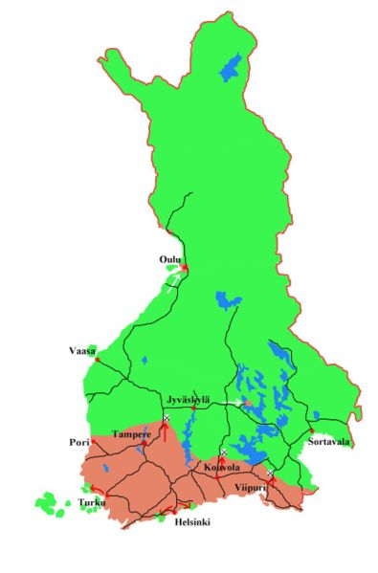
Finnish Immigration to Marquette County, 1905-1920
1880s “First Wave” (Rural) of Finnish immigration.
1904 “Second Wave” (Urban) Russification and political repression.
Marquette Iron Range No Second Wave:
80% (550) green region (rural)
20% (138) red region (urban)
No one from Helsinki
Vihtori Tyynismaa
“Kortesjarvi”
Toivo John Karell
“Vaasa”

Slide 11
Decline in Finnish Born Population, 1900-1930
1910 Populaton Characteristics
39.8% of foreign born population
57% miners (Ishpeming)
55% miners (Negaunee)

Slide 12
Immigration from South and Central Europe, 1900-1930
Italian immigration begins to increase significantly in 1890
(1910) Italians comprise 16% of miners on the Marquette Iron Range
(1920) 87% identified as miners. Mostly labors and trammers

Slide 13
Revolution Failed: the Battle for the Negaunee Labor Temple, 1913
“The Socialistic Finn”
The Labor Temple (1910)
The Finnish Socialist Federation (1906)
“Anarcho-Syndicalism” (William Risto) vs. “Parlimentarism” (Frank Aaltonen)
Labor Temple, Thunder Bay, Ontario

Slide 14
Counter - Revolution
Finnish Republican Club. 350 members

Slide 15
God: Finnish Evangelical Lutheran Church of America
1910 Membership: 2,284 (45% of Finn population)
1920 Membership: 2,994 (65% of Finn population)
Replicate the Church of Finland in the Lake Superior region. Traditionalist, conservative, and favored a paternalistic church and clergy
Many prominent Finnish business men participated in the formation, 1899
Actively adopted a strategy of accommodation with corporate capitalism. Vehemently anti-socialist.
240 people signed anti-socialist resolution following 1907 Mesabi Strike

Slide 16
The Fear of God
Comparison of Suomi Synod LutheranChurch Membership, 1905-1920

Slide 17
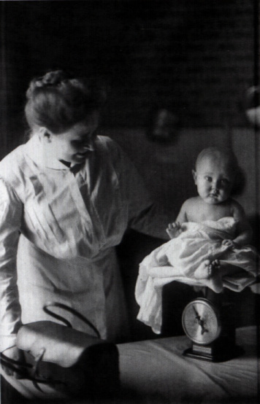
CCI’s Corporate Paternalism
William Mather / “Progressive Era” (Speech to the Lake Superior Iron Mining Association, 1898) Skip to Potty Letters
Low rental housing and support for ownership (CCI owned 600 houses)
Community clubhouses and beautification awards
Pension Plan (1909)
Establishment of Gwinn as a model company town (1907) Gwinn Records
Company sponsored health care Nurses Reports
Visiting doctor and nurse program
Company maintained hospital (Ishpeming, 1918)
Company Initiated Safety Program (1911)

Slide 18
The Potty Letters

Slide 19
Hard Work: CCI Fatalities, 1898 - 1940
Total CCI Fatalities: 321 (1926 does not include Barnes-Hecker)
Total Marquette Iron Range Fatalities: 675
Mesabi Range Death Rate 7.5 / 1000

Slide 20
Hard Work: Deaths by Ethnicity
Time | English | Finnish | Swede | Irish | American | Italian
1900-1909 | 41 | 78 | 20 | 2 | 2 | 22
1910-1919 | 28 | 78 | 7 | 2 | 9 | 23
1920-1929 | 4 | 13 | 1 | 2 | 5 | 6
1930-1940 | 1 | 8 | 0 | 0 | 5 | 5

Slide 21
Hard Work: Reason for Poor Safety Record (Prior to 1911)
Poor discipline in the mines
Contract System (Cornish practice) – Company paid a work team according to output. Worked fast, little oversight.
Demand for labor greater than supply (inexperienced miners)
Lack of laws forcing compensation for fatalities
Employee carelessness
Lake Angeline Mine, Marquette Iron Range

Slide 22
]
Cliffs Shaft Mine: Average Daily Wages and Cost of Production, 1909-1920

Slide 23
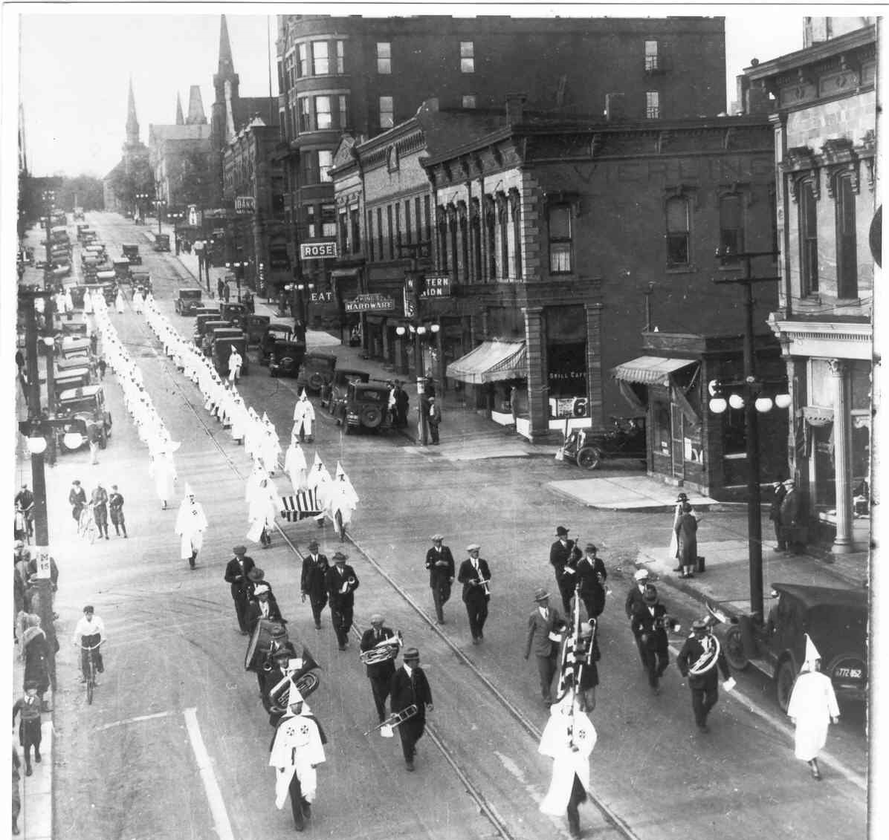

Slide 24
The Second Klan “Movement”
Inspired, in part, by Thomas Dixon’s novel, The Clansman (1905), and D.W. Griffith's film Birth of a Nation (1915)
Founded in Atlanta, Georgia (1915)
Nativist, xenophobic, petty nationalism
Enjoyed wide-spread support, especially in the mid-West and Western states. By 1925, the KKK reputedly had 4.5 million members.
A successful “third party”
KKK March on Washington, 1925.

Slide 25
Protestant Hegemony
Large influx of immigration from southern and central Europe
Virulent anti-Catholicism and anti-Semiticism
Allegiance to papal authority
Prohibition violation, sexual immorality, threats to religion and “traditional family values.”

Slide 26
Anti-Immigration Legislation
The Quota Law of 1921 restricted annual immigration to approximately 350,000 persons. Limited annual immigration from any one country to 3% of 1910 numbers.
Immigration Act of 1924. By 1930, annual immigration limited to 150,000. Disproportionate by ethnicity and country of origin. Asians completely excluded.
Northern European: 86.5 %
Southern / Central Europe: 11.2 %

